Slide 1
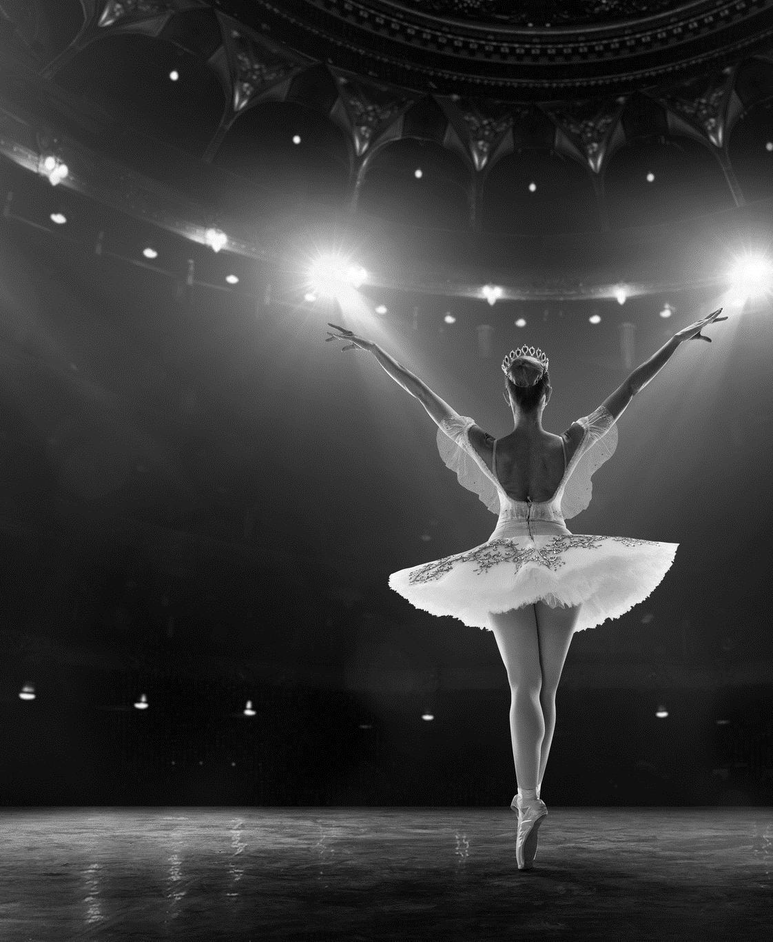


Arts During COVID-19
National Survey October 2020
Prepared by
John O’Mahony
J.202036/JOM

Slide 2

Research Background &
Objectives

Slide 3

Research Background & Objectives
This National Survey was conducted to establish levels of willingness to attend live arts events and alternative formats as Ireland adapts to the COVID- 19 pandemic.
The full programme of interviews was conducted online via B&A’s Online Omnibus and all aspects of the survey were managed by Behaviour & Attitudes internally with the sample drawn from our own consumer panel Acumen.​
B&A’s Online Omnibus is strictly quota controlled to reflect the national population and delivers a sample of 1,000 adults aged 16 years plus.​
The sample selected for the survey is extracted abiding by strict contact rules with individuals randomly selected within the survey target groupings. The quality controls applied to each survey include a series of integrity checks, including time for completion and screening data response patterns.​
Comparisons are drawn with the previous edition of this survey from June.
This research was conducted in Oct 2020.

Slide 4










Sample Profile : Demographics
Base: All Adults aged 16+ n – 1043
 |  | % |  |  |  | %
Gender | Male | 49 |  | Region | Dublin | 29
 | Female | 51 |  |  | Leinster | 27
Age | 18-24 | 14 |  |  | Munster | 27
 | 25-34 | 16 |  |  | Conn/Ulster | 18
 | 35-49 | 30 |  | Area | Urban | 66
 | 50-64 | 22 |  |  | Rural | 34
 | 65+ | 18
Social Class | ABC1F | 49
 | C2DE | 50
Male
Female
49%
51%
Dublin
29%
Urban
66%
Rural
34%
Analysis of Sample

Slide 5

Arts attendance ‘past 12 months’ Pre - Covid

Slide 6
Arts attendance ‘past 12 months’ Pre - COVID
Base: Adults aged 16+ n – 1043
‘Past 12 Months’ Pre – Lockdown’
June | 2018/19 Average
% | %
64 | 53
22 | 20
19 | 17
19 | 20
20 | 19
17 | 13
16 | 17
11 | 16
13 | 8
10 | 7
10 | 10
7 | 5
5 | 5
9 | 14
4 | 7
5 | 6
3 | 7
5 | 7
5 | 4
3 | 2
2 | 4
5 | 6
81 | 79
 | %
85% of Irish adults indicate they attended any arts event in the pre- Covid 12 month period.
Q.1 Thinking back now to the 12 months prior to the start of the Covid 19 crisis in Ireland in March 2020; in those 12 months, from March 2019 to March 2020, did you attend any of the following events outside the home?

Slide 7
Arts attendance ‘past 12 months’ Pre - COVID: Segmentation
Base : All Adults aged 16+ n- 1043
October
‘Past 12 Months’
Pre – COVID
%
June
‘Past 12 Months’
Pre – COVID
%
2018/19
Average
%
1-2 Types
“Occassionals”
3-4 Types
“Regulars”
“Aficionados”
5 + Types
“Films only”
“None”
77% of all Irish adults are ‘arts goers’ (excl. ‘films only’/ ‘none’).
Q.1 Thinking back now to the 12 months prior to the start of the Covid 19 crisis in Ireland in March 2020; in those 12 months, from March 2019 to March 2020, did you attend any of the following events outside the home?

Slide 8

Arts attendance ‘Past 12 months’ Pre Lockdown: Segmentation
Base: All Adults aged 16+ n - 1,043
Share of Art goers
Occasionals 30%
Art goers 77% of pop.
(33%)
Regulars 39%
(38%)
Aficionados 31%
(29%)
(June 2020)
Aficionados account for 31% of all art goers (but a likely much higher percentage of attendances as per previous research).
Q.1 Thinking back now to the 12 months prior to the start of the Covid 19 crisis in Ireland in March 2020; in those 12 months, from March 2019 to March 2020, did you attend any of the following events outside the home?

Slide 9
Arts attendance ‘past 12 months’ Pre - COVID: Segmentation Profile
Base: All Adults aged 16+ n – 1043
 | Total | Arts Segmentation
 |  | Any Arts Goers | Occasional | Regular | Aficionados | Films at a cinema ONLY | None
UNWTD | 1043 | 805 | 230 | 314 | 261 | 89 | 149
 | % | % | % | % | % | % | %
Gender
Male | 49 | 49 | 50 | 49 | 49 | 52 | 47
Female | 51 | 51 | 50 | 51 | 51 | 48 | 53
Age
-24 | 14 | 13 | 19 | 13 | 7 | 26 | 14
25-34 | 16 | 18 | 15 | 17 | 22 | 16 | 9
35-49 | 30 | 30 | 24 | 33 | 34 | 30 | 25
50-64 | 22 | 21 | 22 | 20 | 20 | 17 | 29
65+ | 18 | 18 | 20 | 17 | 17 | 12 | 23
Social Class
ABC1 | 48 | 52 | 52 | 47 | 58 | 43 | 31
C2DE | 50 | 46 | 45 | 52 | 41 | 57 | 68
F | 1 | 2 | 3 | 1 | 1 | - | 1
Region
Dublin | 29 | 29 | 26 | 26 | 36 | 28 | 28
Lein-ster | 27 | 27 | 30 | 29 | 22 | 26 | 25
Mun-ster | 27 | 26 | 25 | 27 | 27 | 34 | 23
Conn/Ulster | 18 | 17 | 19 | 18 | 15 | 12 | 23
Area
Urban | 66 | 67 | 63 | 64 | 74 | 70 | 59
Rural | 34 | 33 | 37 | 36 | 26 | 30 | 41
In demographic terms, ‘Aficionados’ are primarily distinctive in relation to social grade – being much more likely to be ABC1; also higher among urban residents.
Q.1 Thinking back now to the 12 months prior to the start of the Covid 19 crisis in Ireland in March 2020; in those 12 months, from March 2019 to March 2020, did you attend any of the following events outside the home?

Slide 10
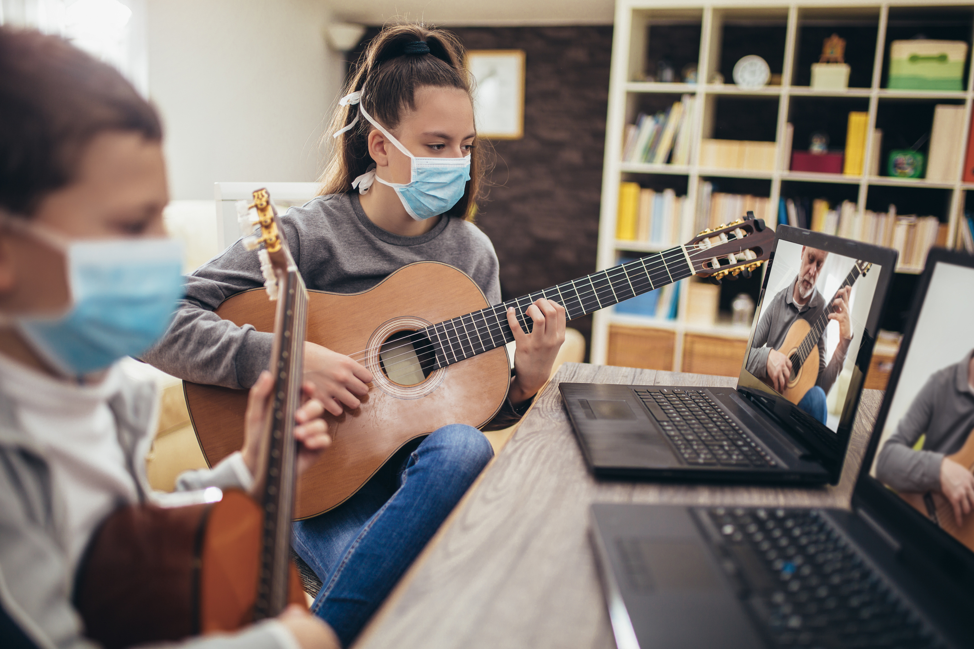
The Arts & Living with Covid

Slide 11
Level of concern with attending arts events/ venues (October 2020)
Base: Adults aged 16+ n – 1043
Music or other performance in a standing indoor venue | Concert Hall/Opera House (indoors) | Theatre, Music, Dance or talk in a seated indoor venue | Multiplex Cinema | Art Gallery (indoors) | Music or other performance at an outdoor venue | Street arts (e.g. outdoor based performance/ parade/ carnival/ circus)
% | % | % | % | % | % | %
Very concerned
Somewhat concerned
Not very concerned
Not at all concerned
Any Concern | 81 |  | 75 |  | 75 |  | 70 |  | 63 |  | 58 |  | 52
The high levels of concern at attending live arts events continue in October 2020; as does the distinction between indoor and outdoor venues.
Q.2 How concerned are you about attending an arts event in the following venues ...

Slide 12
Level of concern with attending arts events/ venues (October 2020)
Base: All adults aged 16+ n – 1, 043
Somewhat concerned | Very concerned
Any concern
Music or other performance in a standing indoor venue
(81)
(78)
(75)
(76)
(75)
(75)
(70)
(74)
(63)
(65)
(58)
(61)
(52)
(56)
Concert Hall/Opera House (indoors)
Theatre, Music, Dance or talk in a seated indoor venue
Multiplex Cinema
Art Gallery (indoors)
Music or other performance at an outdoor venue
Street arts (e.g. outdoor based performance/ parade/ carnival/ circus)
Our levels of concern attending indoor venues in particular remain very high; however levels can show a slight decline since June.
Q.2 How concerned are you about attending an arts event in the following venues ...

Slide 13
Level of concern with attending arts events/venues:
Very concerned x Arts segmentation
Base: Adults aged 16+ n – 1043
Very concerned | Total | Arts Segmentation
 |  | Any Arts Goers | Occasional | Regular | Aficionados | Films at a cinema ONLY | None
Base | 1043 | 805 | 230 | 314 | 261 | 89 | 149
 | % | % | % | % | % | % | %
Music or other performance in a standing indoor venue | 46 | 48 | 49 | 47 | 49 | 37 | 41
Concert Hall/Opera House (indoors) | 35 | 34 | 36 | 30 | 38 | 29 | 40
Theatre, Music, Dance or talk in a seated indoor venue | 33 | 33 | 34 | 29 | 37 | 28 | 37
Multiplex Cinema | 31 | 30 | 30 | 28 | 31 | 30 | 37
Art Gallery (indoors) | 25 | 24 | 28 | 21 | 22 | 24 | 30
Music or other performance at an outdoor venue | 17 | 17 | 21 | 14 | 17 | 16 | 18
Street arts (e.g. outdoor based performance/ parade/ carnival/ circus) | 15 | 14 | 18 | 12 | 14 | 13 | 19
Aficionados are again typically the most concerned with attending indoor venues.
Q.2 How concerned are you about attending an arts event in the following venues ...

Slide 14
Level of concern with attending arts events/venues:
Very concerned x demographics
Base: Adults aged 16+ n – 1043
Very Concerned | Total | Gender |  | Age |  |  |  |  | Social Class |  | Region |  | Area
 |  | Male | Female | -24 | 25-34 | 35-49 | 50-64 | 65+ | ABC1F | C2DE | Dublin | Outside Dublin | Urban | Rural
Base: | 1043 | 512 | 531 | 94 | 179 | 333 | 258 | 179 | 509 | 534 | 325 | 718 | 790 | 253
 | % | % | % | % | % | % | % | % | % | % | % | % | % | %
Music or other performance in a standing indoor venue | 46 | 45 | 47 | 37 | 43 | 46 | 45 | 57 | 47 | 45 | 43 | 47 | 44 | 50
Concert Hall/Opera House (indoors) | 35 | 34 | 36 | 20 | 31 | 37 | 37 | 43 | 34 | 35 | 31 | 36 | 33 | 37
Theatre, Music, Dance or talk in a seated indoor venue | 33 | 32 | 34 | 20 | 29 | 35 | 35 | 43 | 33 | 34 | 28 | 35 | 31 | 38
Multiplex Cinema | 31 | 33 | 29 | 21 | 25 | 30 | 33 | 42 | 30 | 31 | 31 | 31 | 30 | 33
Art Gallery (indoors) | 25 | 24 | 25 | 16 | 22 | 26 | 25 | 30 | 23 | 26 | 18 | 27 | 23 | 28
Music or other performance at an outdoor venue | 17 | 18 | 16 | 9 | 23 | 18 | 16 | 18 | 17 | 18 | 15 | 18 | 17 | 17
Street arts (e.g. outdoor based performance/ parade/ carnival/ circus) | 15 | 15 | 14 | 9 | 16 | 15 | 16 | 16 | 13 | 16 | 11 | 16 | 14 | 16
Levels of concern increase with age, being much lower among those under 24 years.
Q.2 How concerned are you about attending an arts event in the following venues ...

Slide 15
What can venues do to encourage attendance?
Base: Adults aged 16+ n – 1043
More likely to visit a venue for a live arts performance if …
October 2020
June 2020
 | %
 | %
There was a limit on the numbers attending so the venue is partially full
All attendees having their temperature checked prior to entering the venue
Being supplied with clinical face masks prior to entering the venue
Ticket prices were temporarily reduced for a period of time (until the end of the year)
Being supplied with clinical gloves and hand disinfectant prior to entering the venue
The bar area remains closed
You are required to sign a waiver prior to attending, absolving the venue of the risk of you being exposed to, or accidentally exposing others to coronavirus
Ticket prices were temporarily increased for a period of time (until the end of the year)
There was a limit on the numbers attending so the venue is partially full
All attendees having their temperature checked prior to entering the venue
Being supplied with clinical face masks prior to entering the venue
Ticket prices were temporarily reduced for a period of time (until the end of the year)
Being supplied with clinical gloves and hand disinfectant prior to entering the venue
The bar area remains closed
You are required to sign a waiver prior to attending, absolving the venue of the risk of you being exposed to, or accidentally exposing others to coronavirus
Ticket prices were temporarily increased for a period of time (until the end of the year)
N/A
The reassurances provided by limited numbers, face masks and discounts has increased since June; note also the prominence of ‘temperature checks’.
Q.3 When stay-at-home requirements are lifted, to what extent would ... make you more or less likely to visit a venue for a live arts performance?

Slide 16
What can venues do to encourage attendance?
Base: Adults aged 16+ n – 1043
More likely if… | Total | Arts Segmentation
 |  | Any Arts Goers | Occasional | Regular | Aficionados | Films at a cinema ONLY | None
Base | 1043 | 805 | 230 | 314 | 261 | 89 | 149
 | % | % | % | % | % | % | %
There was a limit on the numbers attending so the venue is partially full | 67 | 71 | 62 | 78 | 70 | 63 | 52
All attendees having their temperature checked prior to entering the venue | 56 | 58 | 54 | 63 | 55 | 56 | 45
Being supplied with clinical face masks prior to entering the venue | 50 | 52 | 46 | 56 | 52 | 51 | 40
Ticket prices were temporarily reduced for a period of time (until the end of the year) | 43 | 46 | 40 | 50 | 48 | 43 | 25
Being supplied with clinical gloves and hand disinfectant prior to entering the venue | 42 | 43 | 37 | 47 | 44 | 41 | 39
The bar area remains closed | 35 | 37 | 35 | 39 | 35 | 34 | 27
You are required to sign a waiver prior to attending, absolving the venue of the risk of you being exposed to, or accidentally exposing others to coronavirus | 16 | 16 | 15 | 17 | 15 | 13 | 18
Ticket prices were temporarily increased for a period of time (until the end of the year) | 7 | 7 | 6 | 8 | 8 | 8 | 8
Average ‘More Likely’ | 40 | 41 | 37 | 45 | 41 | 39 | 32
The positive impact of the initiatives is broadly similar across the various attendee groups; peaking among ‘Regulars’.
Q.3 When stay-at-home requirements are lifted, to what extent would ... make you more or less likely to visit a venue for a live arts performance?

Slide 17
What can venues do to encourage attendance?
Base: Adults aged 16+ n – 1043
More likely if… | Total | Gender |  | Age |  |  |  |  | Social Class |  | Region |  | Area
 |  | Male | Female | -24 | 25-34 | 35-49 | 50-64 | 65+ | ABC1F | C2DE | Dublin | Outside Dublin | Urban | Rural
Base | 1043 | 512 | 531 | 94 | 179 | 333 | 258 | 179 | 509 | 534 | 325 | 718 | 790 | 253
 | % | % | % | % | % | % | % | % | % | % | % | % | % | %
There was a limit on the numbers attending so the venue is partially full | 67 | 66 | 69 | 61 | 72 | 69 | 66 | 67 | 71 | 64 | 72 | 65 | 67 | 67
All attendees having their temperature checked prior to entering the venue | 56 | 55 | 57 | 60 | 55 | 54 | 54 | 60 | 58 | 54 | 58 | 55 | 57 | 54
Being supplied with clinical face masks prior to entering the venue | 50 | 49 | 50 | 49 | 54 | 47 | 49 | 52 | 52 | 47 | 53 | 49 | 50 | 49
Ticket prices were temporarily reduced for a period of time (until the end of the year) | 43 | 45 | 41 | 49 | 49 | 48 | 38 | 30 | 47 | 39 | 48 | 41 | 46 | 38
Being supplied with clinical gloves and hand disinfectant prior to entering the venue | 42 | 41 | 43 | 43 | 44 | 39 | 43 | 44 | 41 | 43 | 47 | 40 | 43 | 40
The bar area remains closed | 35 | 31 | 38 | 25 | 32 | 32 | 38 | 47 | 32 | 37 | 34 | 35 | 33 | 39
You are required to sign a waiver prior to attending, absolving the venue of the risk of you being exposed to, or accidentally exposing others to coronavirus | 16 | 16 | 16 | 22 | 21 | 14 | 15 | 11 | 18 | 13 | 17 | 15 | 16 | 15
Ticket prices were temporarily increased for a period of time (until the end of the year) | 7 | 7 | 8 | 5 | 7 | 10 | 7 | 6 | 7 | 8 | 8 | 7 | 7 | 8
Average ‘More Likely’ | 40 | 39 | 40 | 39 | 42 | 39 | 39 | 40 | 41 | 38 | 42 | 38 | 40 | 39
The positive impact of the initiatives is also broadly comparable by key demographics. Temporary discounting most effective with younger age groups.
Q.3 When stay-at-home requirements are lifted, to what extent would ... make you more or less likely to visit a venue for a live arts performance?

Slide 18
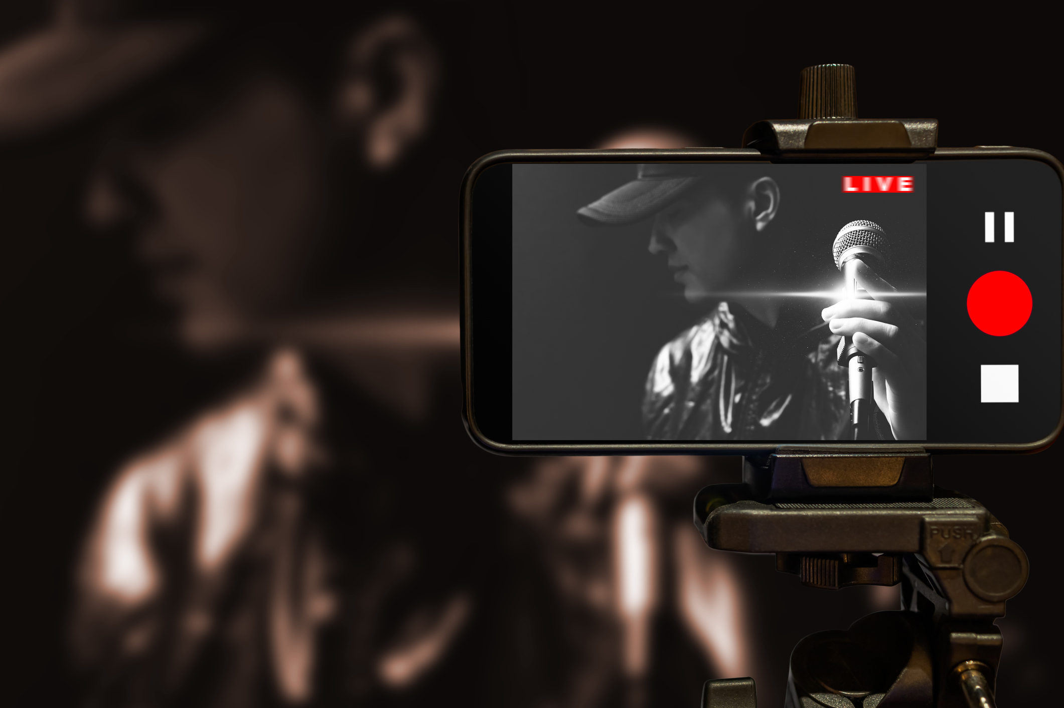
Online Arts Engagement

Slide 19
Arts Engagement Online: During COVID
Base: Adults aged 16+ n – 1043
During COVID
October 2020
June 2020
 | %
 | %
ANY
Watched a play, concert, opera or other artistic output online
Participated in an online arts class/ group /tutorial
Any Pre-COVID
Q.4b And since the Irish government implemented physical distancing measures in response to the Covid 19 virus, have you done either of the following online/ on the internet?
Engagement with the Arts online continues to rise, being 36% of all adults in October.

Slide 20
Arts Engagement Online: During COVID
Base: Adults aged 16+ n – 1043
 | TOTAL | ARTS SEGMENTATION
 |  | Any Arts Goers | Occasionals | Regulars | Aficionados | Films (only) | None
Base | 1043 | 805 | 230 | 314 | 261 | 89 | 149
 | % | % | % | % | % | % | %
During COVID
ANY | 36 | 42 | 31 | 35 | 61 | 16 | 18
Watched a play, concert, opera or other artistic output online | 26 | 30 | 22 | 22 | 49 | 9 | 15
Participated in an online arts class/ group /tutorial | 19 | 22 | 12 | 21 | 33 | 9 | 7
The incidence of online engagement among Aficionados is very high at 61%; confirms the importance of Irish Arts availability online; also likely opportunity to encourage higher engagement from Regulars.
Q.4a Thinking back again to the 12 months prior to the start of the Covid 19 crisis in Ireland in March 2020; in those 12 months, from March 2019 to March 2020, did you do either of the following online/ on the internet?
Q.4b And since the Irish government implemented physical distancing measures in response to the Covid 19 virus, have you done either of the following online/ on the internet?

Slide 21
Arts Engagement Online: During COVID
Base: Adults aged 16+ n – 1043
 | TOTAL | Gender |  | Age |  |  |  |  | Social Class |  | Region |  | Area
 |  | Male | Female | -24 | 25-34 | 35-49 | 50-64 | 65+ | ABC1F | C2DE | Dublin | Outside Dublin | Urban | Rural
Base | 1043 | 512 | 531 | 94 | 179 | 333 | 258 | 179 | 509 | 534 | 325 | 718 | 790 | 253
 | % | % | % | % | % | % | % | % | % | % | % | % | % | %
During COVID
ANY | 36 | 35 | 38 | 35 | 39 | 38 | 34 | 35 | 41 | 31 | 46 | 32 | 41 | 27
Watched a play, concert, opera or other artistic output online | 26 | 26 | 26 | 22 | 28 | 26 | 25 | 30 | 30 | 23 | 32 | 24 | 30 | 19
Participated in an online arts class/ group /tutorial | 19 | 16 | 21 | 20 | 23 | 23 | 14 | 12 | 22 | 15 | 27 | 15 | 21 | 13
Demographically, online arts engagement shows only modest variation, albeit higher in Dublin and weaker in Rural areas.
Q.4a Thinking back again to the 12 months prior to the start of the Covid 19 crisis in Ireland in March 2020; in those 12 months, from March 2019 to March 2020, did you do either of the following online/ on the internet?
Q.4b And since the Irish government implemented physical distancing measures in response to the Covid 19 virus, have you done either of the following online/ on the internet?

Slide 22
Future Arts Engagement Online: Willing to pay for access
Base: Engaged with Arts Online either ‘past 12 months’ or during Lockdown n - 446
Watching a play, concert, opera or other artistic output online by Irish artists you enjoy
Participating in an online arts class/group/tutorial
Oct 2020 % | June 2020 %
Oct 2020 % | June 2020 %
Yes | Yes
Yes | Yes
71% Afficionados
72% Under 34 years
60% Afficionados
63% Under 34 years
Willingness to pay for future online arts activities among recent users has risen in October with 64% willing to pay to watch plays, concerts etc.
Q.5 In future, would you be willing to pay for accessing the following online content?

Slide 23
Future Arts Engagement Online: Willing to pay for access
Base: Engaged with Arts Online either ‘past 12 months’ or during Lockdown n - 446
Watching a play, concert, opera or other artistic output online by Irish artists you enjoy
Participating in an online arts class/group/tutorial
 | %
 | %
Willingness to pay for future online arts activities among recent users is largely consistent demographically for watching plays, concerts, artistic output etc.
Q.5 In future, would you be willing to pay for accessing the following online content?

Slide 24


a
Summary & Conclusions
Notes:
“&” estourado do lado direito. – como tava antes.

Slide 25
Summary & Conclusions
The high level of concern at attending live arts events continues in October 2020; as does the distinction between indoor and outdoor venues; however levels can show a slight decline since June.
Levels of concern increase with age, being much lower among those under 24 years. Aficionados are again typically the most concerned with attending indoor venues.
The reassurances provided by limited numbers, face masks and temporary discounts has increased since June; encouragement provided by ‘temperature checks’ is also prominent.
The positive impact of the initiatives is broadly comparable across the various attendee groups and by key demographics. Temporary discounting is most effective with younger age groups.
Engagement with the Arts online continues to rise, being 36% of all adults in October. The incidence of online engagement among Aficionados is very high at 61%; confirming the importance of Irish Arts being extensively available online; there is also likely an opportunity to encourage higher online engagement from Regulars.
Willingness to pay for future online arts activities among recent users has risen in October with 64% willing to pay to watch plays, concerts etc, and this is largely consistent demographically.

Slide 26

Thank you.
Milltown House
Mount Saint Annes
Milltown, Dublin 6 - D06 Y822
+353 1 205 7500 | www.banda.ie

